Slide 1
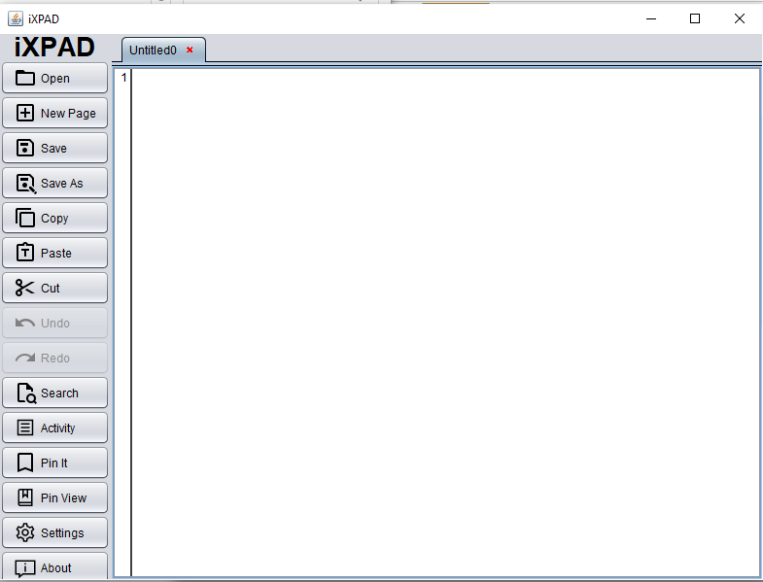
iXPAD

Slide 2
Supervisor:
Falguni Roy
Lecturer, IIT, NSTU
Submitted By: Abrar Hossain(ASH1825005M) Azad Hossain(ASH1825014M) Saima Nawal(MUH1825041F)

Slide 3
Introduction
This is a text editor like notepad. Basically we add some wow feature in this text editor such as checking duplicity of two files, bookmark file, spell checking, English word meaning.

Slide 4
Requirements
• Bookmarking ability
• Checking duplicity of any text files
• Capitalization of sentences or words
• Line number
• Multiple tab
• Show recent opened files
• Dark & Light theme
• Syntax highlighting for C & C++ programming languages
• Suggestions for words
• Spell Checking
• Dictionary

Slide 5
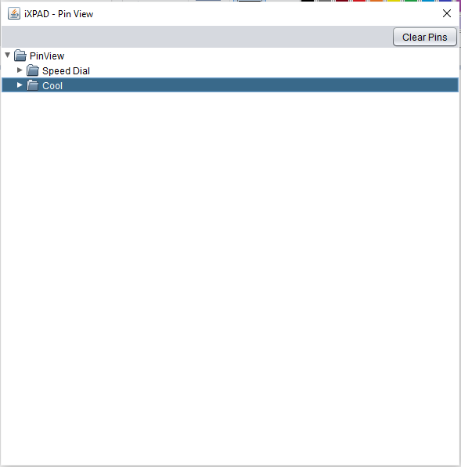
Bookmark
If you think you need this tab later. Then you can bookmark it. When you need this tab , then you can easily going these tab by clicking bookmark view.

Slide 6
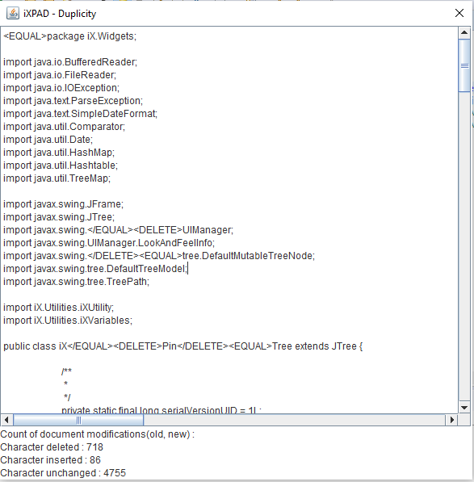
Checking duplicity
We can check duplicity of two files by this feature.

Slide 7
Capitalization of sentences
In this feature first word will be capitalize.

Slide 8
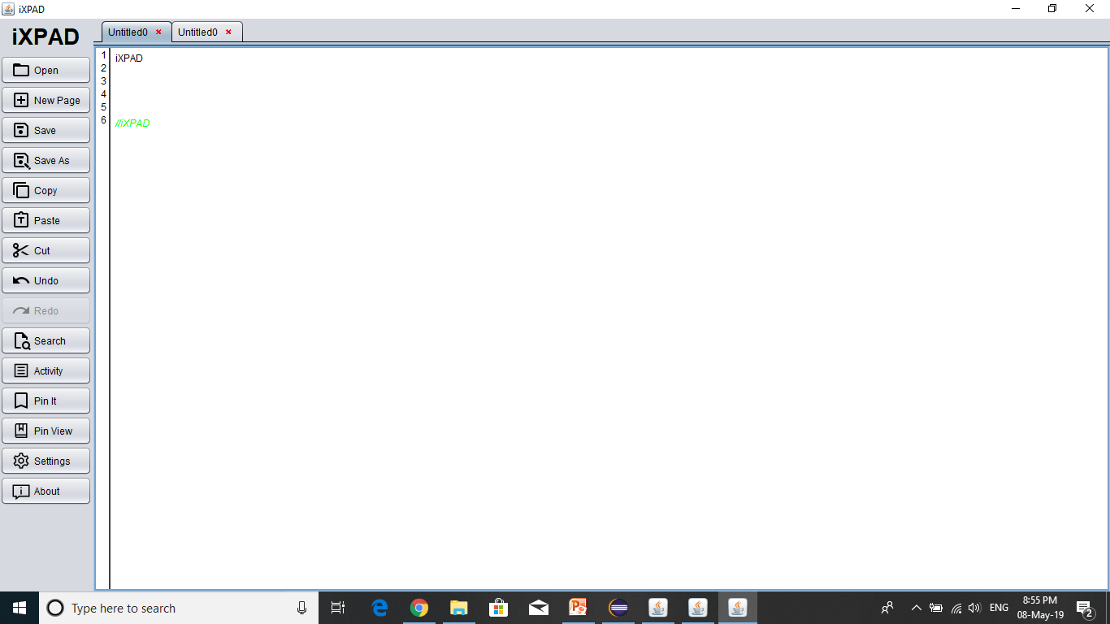
Line number
In this feature we can know what is the number of text editor.

Slide 9
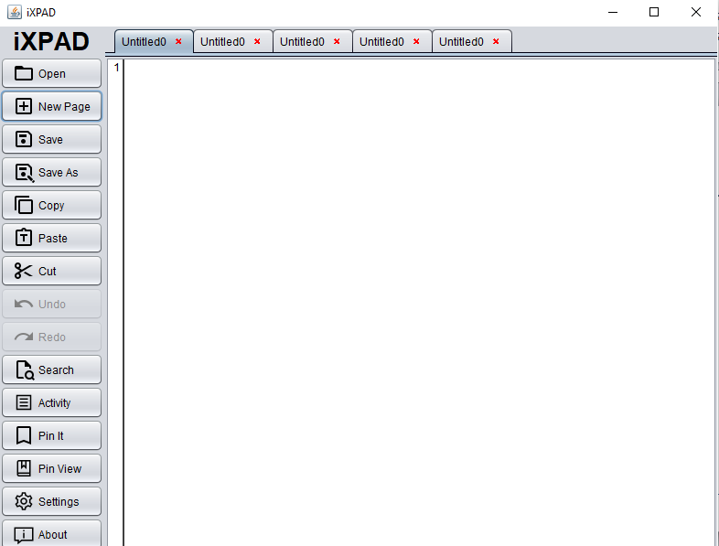
Multiple tab

Slide 10
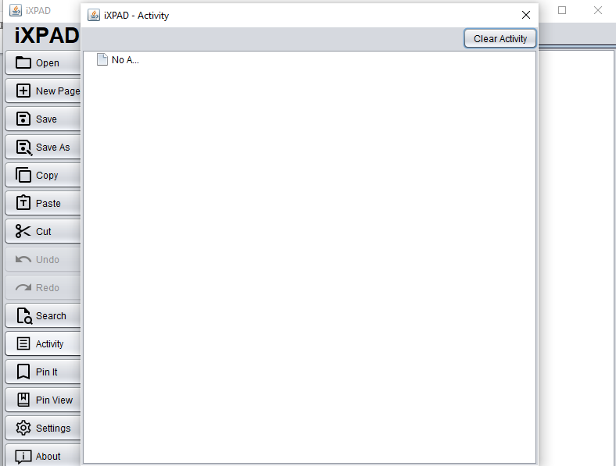
Show recent opened files
In this feature we can see files which we used recently.

Slide 11
Dark & Light theme
Dark & Light theme are widget of window.

Slide 12
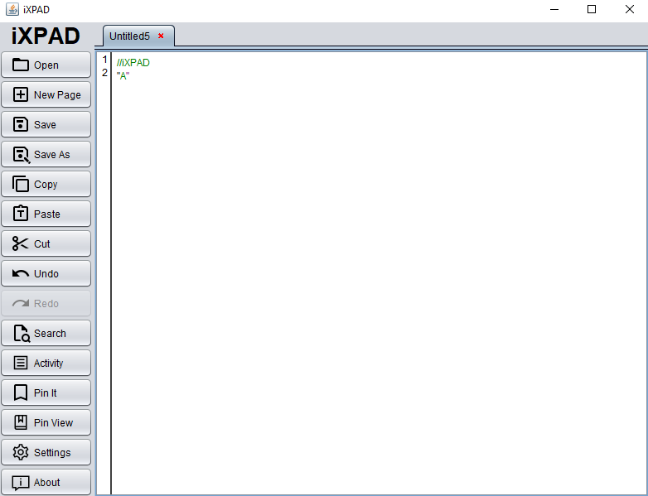
Syntax highlighting
In this feature we can highlighting Syntax for C & C++ programming languages.

Slide 13
Spell Checking
In this feature we can spell chek.

Slide 14
Dictionary
In this feature we can know the meaning of English word.

Slide 15
Project Output

